Slide 1
sPRINT #4: 3 MINUTE THESIS LAB FACILITATION GUIDE

Slide 2
Sprint 4 Assignment
Select one of the following research papers to do a 3-minute thesis on.
Ice cream
The future of social media in marketing
The evolution of animal domestication
Create a 3-minute thesis and submit it on Gradescope.
The Gradescope submission will include:
1 initial video recording uploaded to YouTube. Students do not need to add closed captions to this professional development assignment.

Slide 3
guidelines for 3MT Professional development

Slide 4
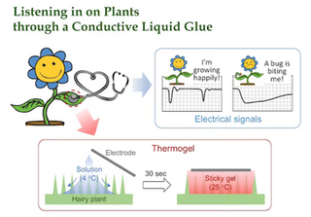
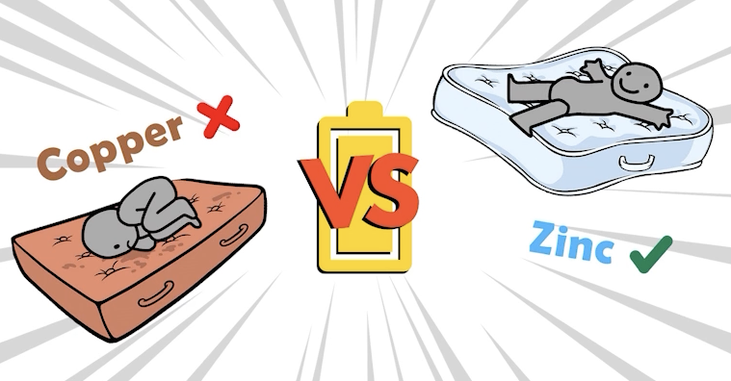
Sprint 4 Assignment
You may use 5-6 PowerPoint slides, and you may include transitions or animations.
You are limited to 3 minutes maximum.
2 minutes minimum.
Presentations are to be spoken word (e.g. no poems, raps, or songs)
2020 Asia-Pacific 3MT Final Winner - Luo Yifei - “Listening in on Plants through a Conductive Liquid Glue”
2023 UQ 3MT Final Winner - Emily Cooper - “The best mattress is a zinc mattress”

Slide 5
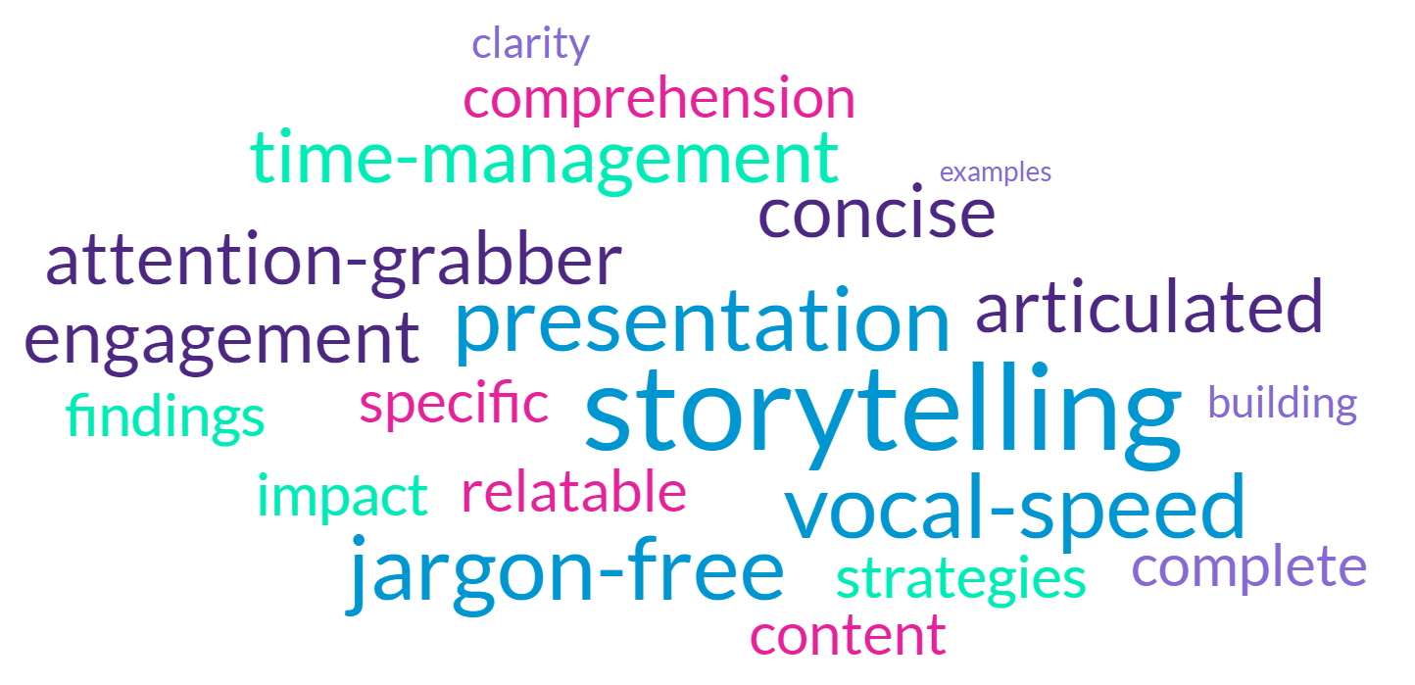
Sprint 4 Assignment

Slide 6
Sprint 4 Rubric
Content Clarity (15 points)
Logical Flow(15 points)
Project Relevance & Impact(15 points)
Engagement(15 points)
Slide Design(15 points)
Delivery(10 points)
ADA Closed Caption(10 points)
Duration(5 points)
Full rubric: https://the-examples-book.com/crp/students/spring2025/video_guidelines#rubric

Slide 7
Examples

Slide 8
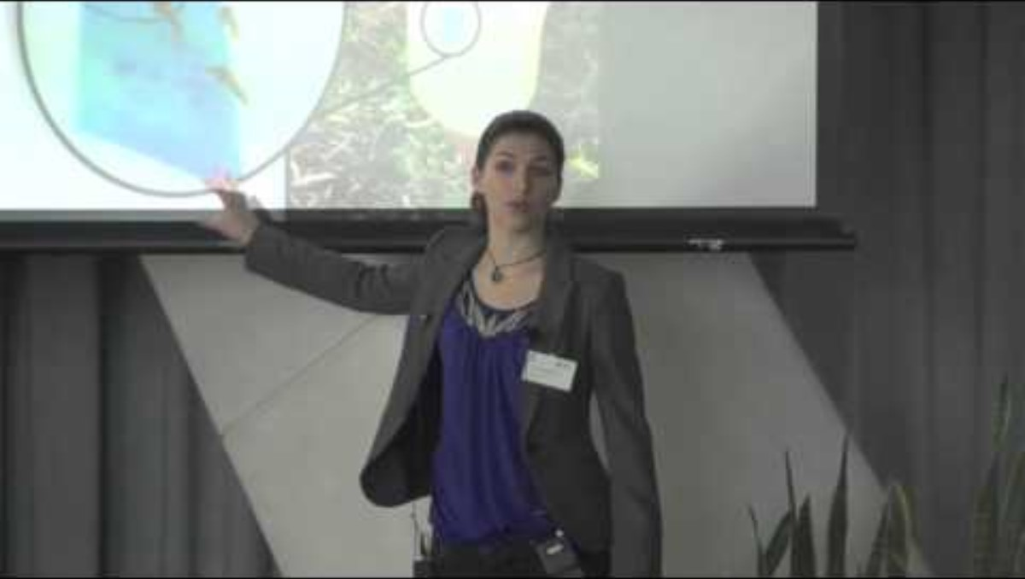
3 Minute Thesis Example
Other examples https://threeminutethesis.uq.edu.au/watch-3mt

